Slide 1
PROPERTIES OF CARBON COMPOUNDS

Slide 2
HOMOLOGY

Slide 3
FUNCTIONAL GROUP
Functional groups are specific groups of atoms within molecules that have very characteristic properties regardless of the other atoms present in a molecule

Slide 4
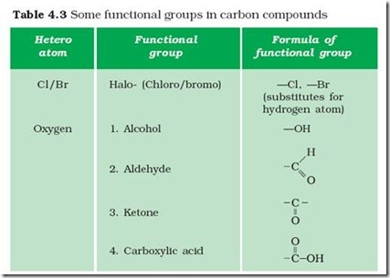
FUNCTIONAL GROUP

Slide 5
ISOMERISM
What is Isomerism?
It is a phenomenon where two or more compounds have the same chemical formula but possesses different structural formulas, that is, different properties. This is mainly because of different structural or spatial arrangements. Isomers are the compounds exhibiting isomerism.

